Slide 1
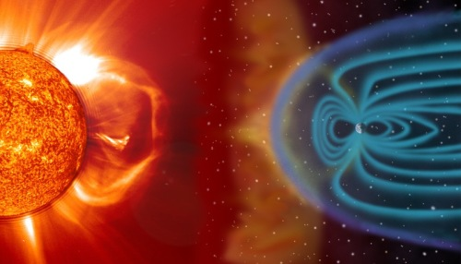
Develop the Oracle
of DSCOVR
Team Members:
Marcus
Jun Sheng
Gavin
Yong De
Gamal

Slide 2
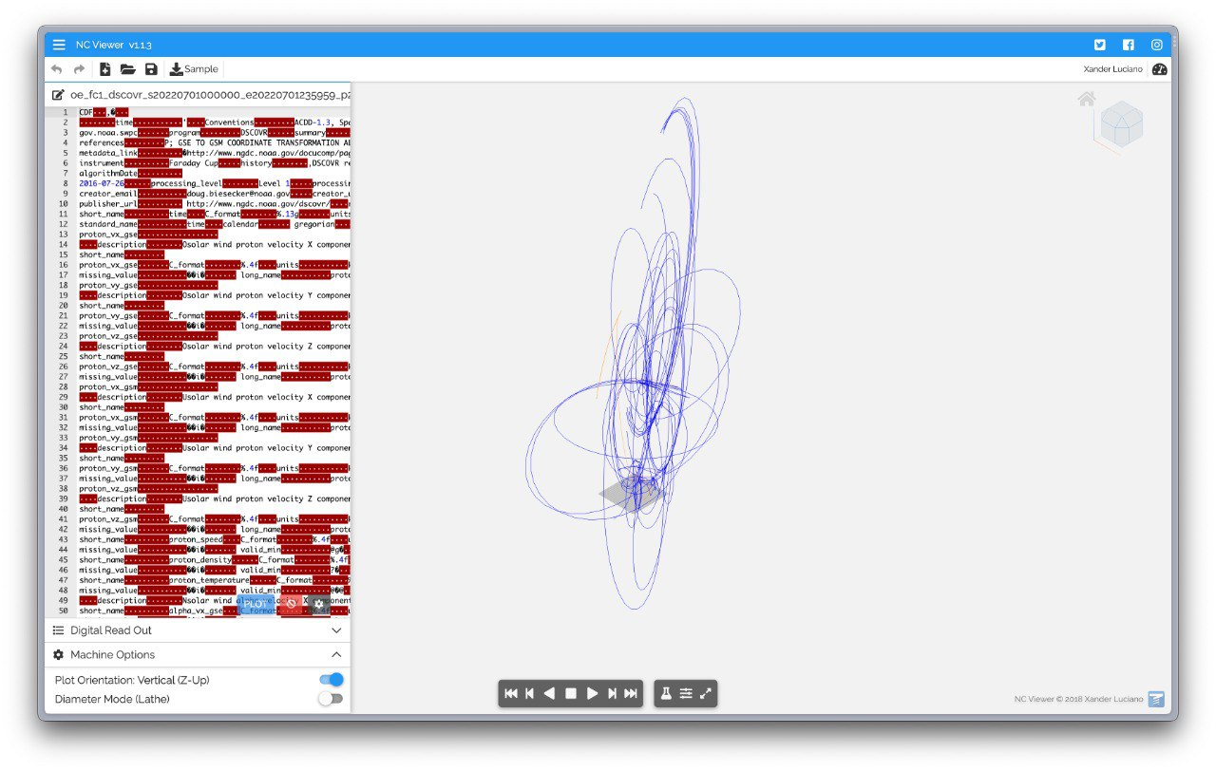
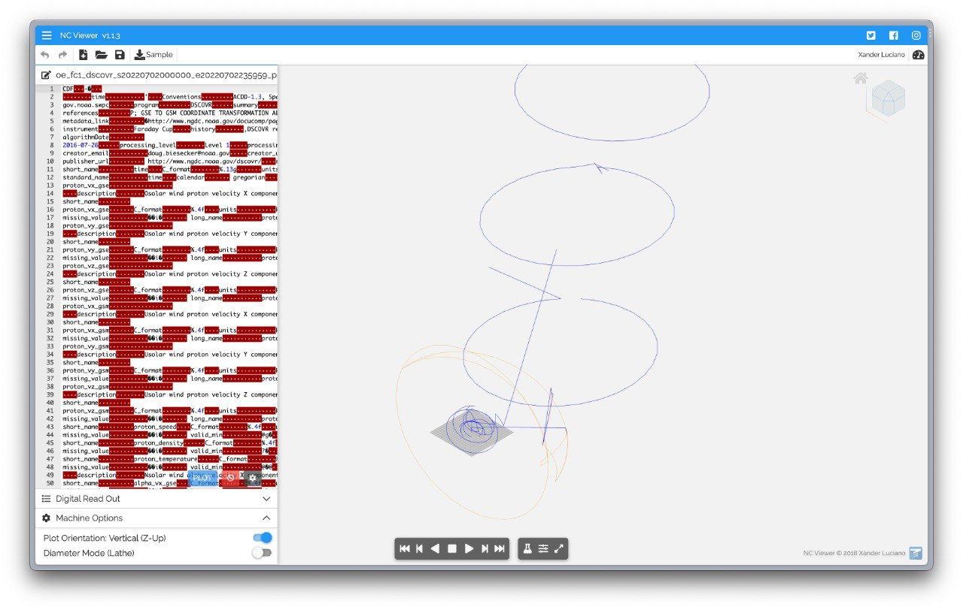
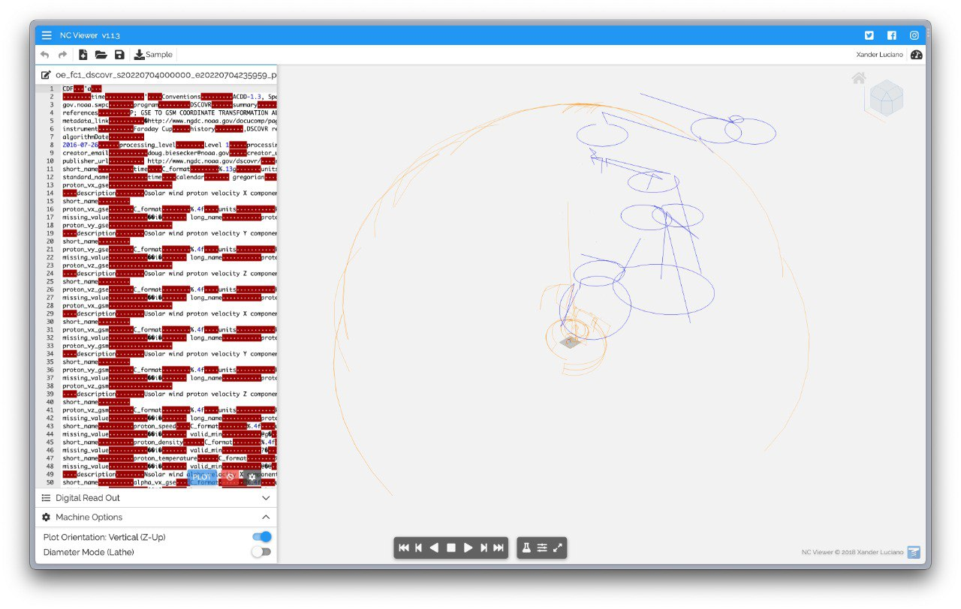
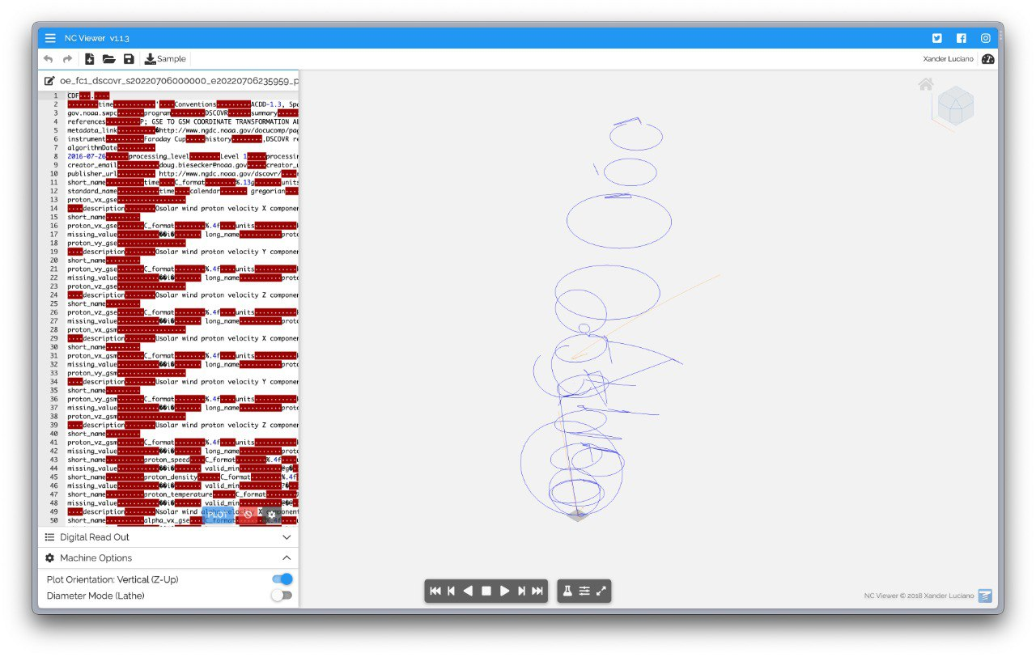
OPEN DATA BY SPACE AGENCY
Utilising the open-sourced DSCOVR data.
Extracted with NC Viewer to derive the respective 3D representations of the magnetic field strength.

Slide 3
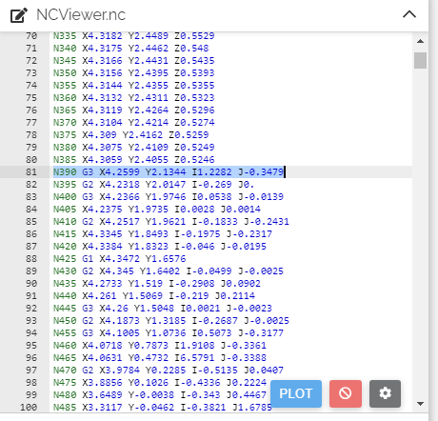
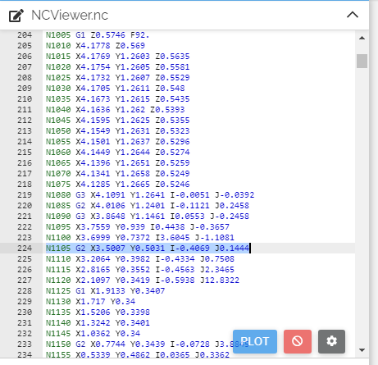
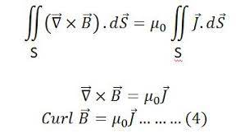
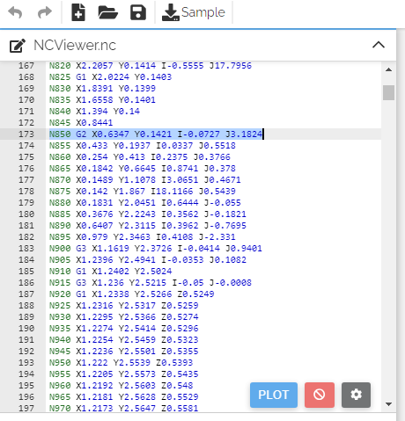
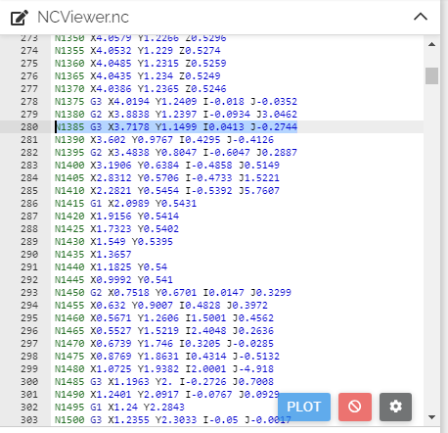
Building on the data we obtained from the NOAA FCA1 data set. We have X and Y along with provided X and Y components of the Electric Field Current Density.
Using the Equation:
Since we have Jx and Jy, we easily obtain the electric filed Intensity Vector B ​

Slide 4
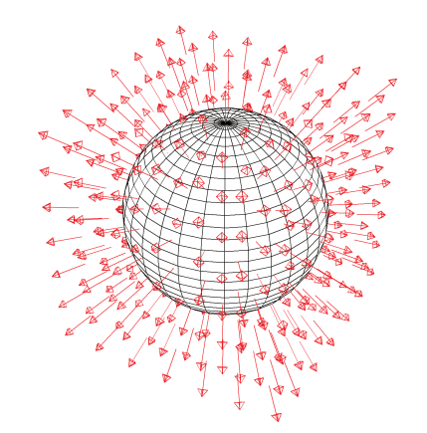
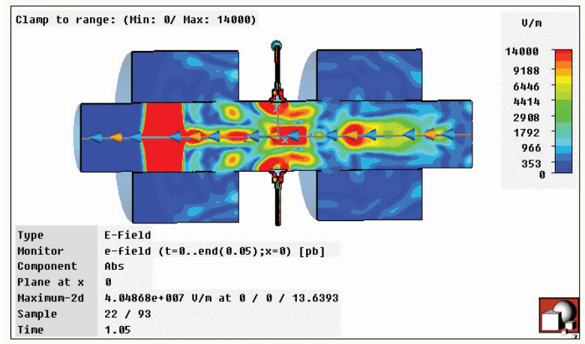
Snapshot of a numerical solution to Maxwell’s equations for a bunch of electrons moving through a beam position monitor in an accelerator vacuum chamber. The colors show the strength of the electric field. The bunch is moving from right to left: the location of the bunch corresponds to the large region of high field intensity towards the left-hand side. (Image courtesy of M. Korostelev.)
Electric field lines from a point charge q. The field lines are everywhere perpendicular to a spherical surface centred on the charge.

Slide 5
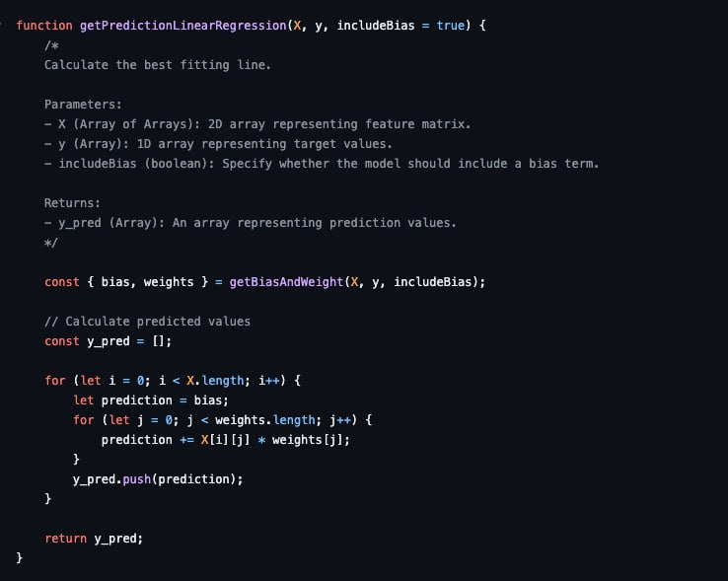
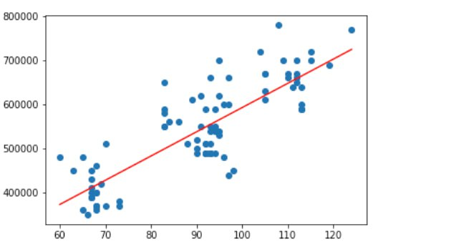
PREDICTIVE MODEL – LINEAR REGRESSION
Linear regression model -> accounts for a bias in the dataset and predict future values with a best fit line.
Employed the React application to encapsulate the model and retrieve the data in a 2D -> Scatter Plot and Line of Best Fit
OUTPUT EXAMPLE

Slide 6
References:
https://cds.cern.ch/record/1400571/files/p15.pdf
https://www.ngdc.noaa.gov/dscovr/data/2022/07/

